Slide 1
HEALTH CARE
REFORM
WHAT IT
MEANS FOR YOU

Slide 3
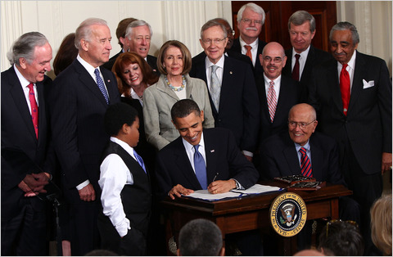

Slide 4
WHY DID WE NEED HEALTH CARE
REFORM?
WHAT DID WE WIN?
MYTHS AND LIES
SUMMING UP

Slide 5
QUIZ

Slide 6
How many additional New
Yorkers will get insurance under
the new law?
500,000
1 million
2 million
5 million

Slide 7
How many additional New
Yorkers will get insurance under
the new law?
500,000
1 million
2 million
5 million

Slide 8
How many small businesses
in New York are eligible for
the tax credits provided
under the new law?
120,000
210,000
320,000
285,000

Slide 9
How many small businesses
in New York will potentially
get the tax credits provided
under the new law?
120,000
210,000
320,000
285,000

Slide 10
How many seniors
and disabled received a $250 rebate check?
1 million
2 million
3 million
4 million

Slide 11
How many seniors
and disabled received a $250 rebate check?
1 million
2 million
3 million
4 million

Slide 12
Why Reform?

Slide 14
$

Slide 15
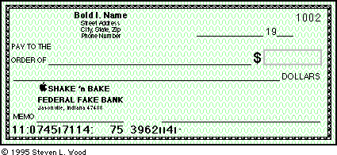

Slide 16
BANKRUPTCIES
OTHER
OTHER

Slide 17
WHO DO YOU KNOW?
DROPPED
DENIED CLAIMS
DELAYED CLAIMS

Slide 18
Costs Double
Without Reform

Slide 19
WHO DO YOU KNOW?

Slide 20
HOW DID WE GET HERE?

Slide 21
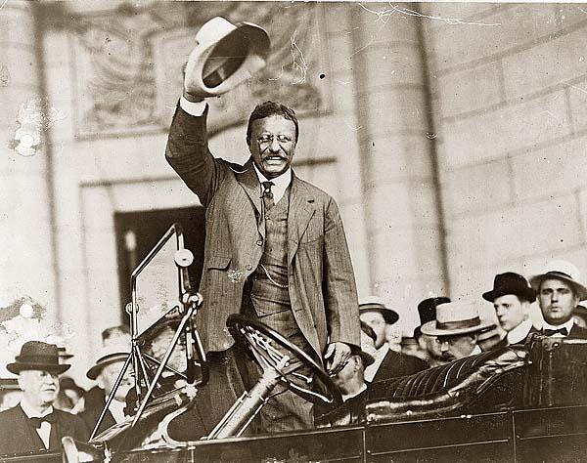

Slide 22
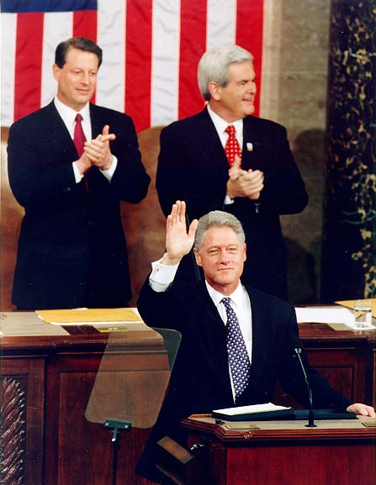

Slide 23
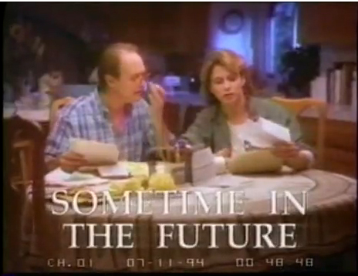

Slide 24
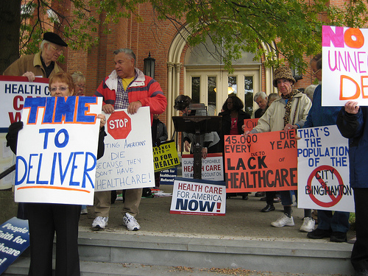

Slide 25
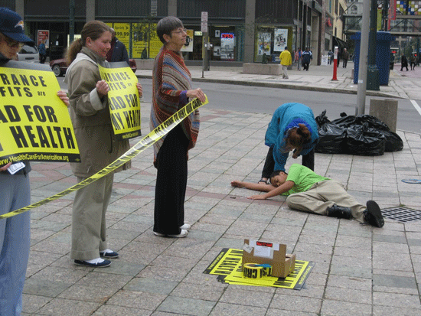

Slide 26
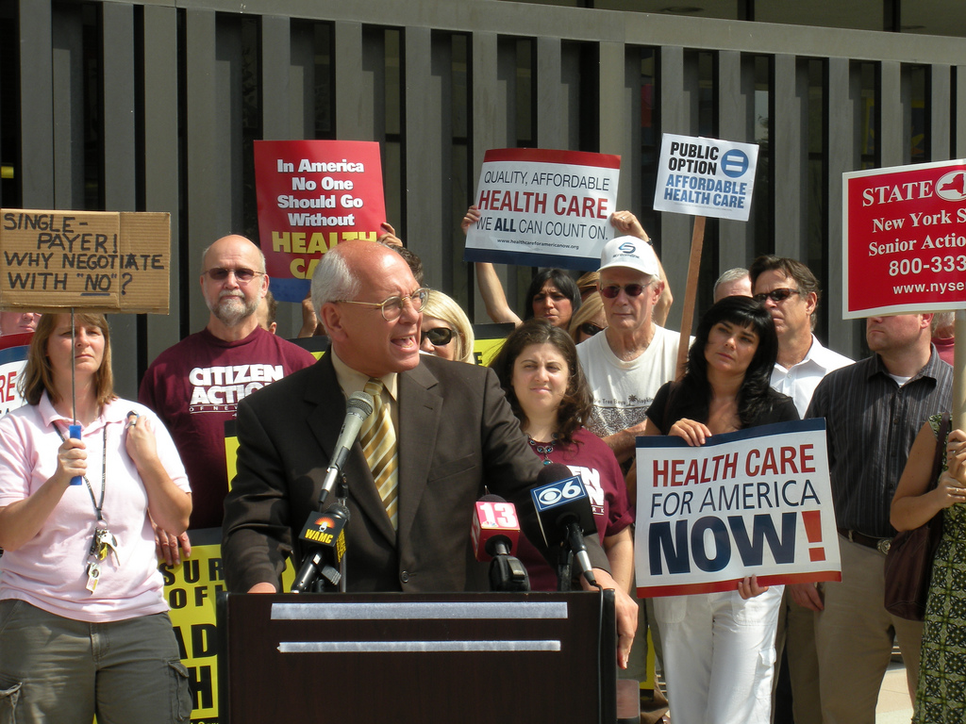

Slide 27
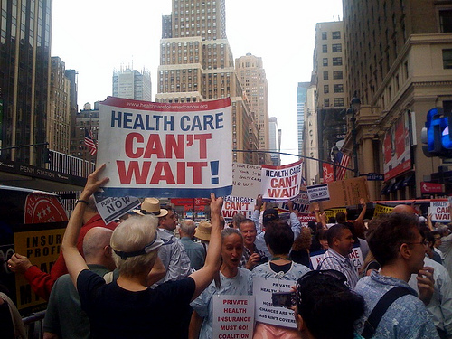

Slide 28
WHAT WILL
WE GET?

Slide 29
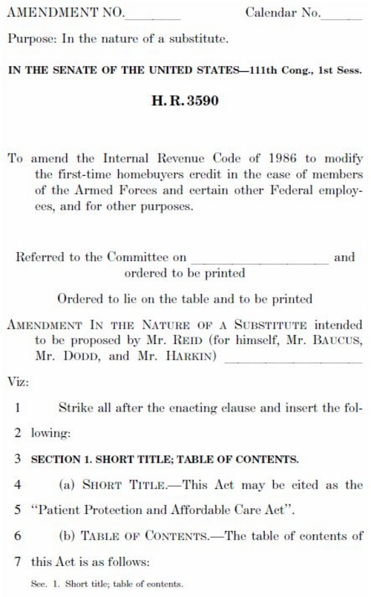

Slide 30
Seniors and
the disabled
Pay full drug costs after
incurring $3,600 in
Medicare Part D plans

Slide 31
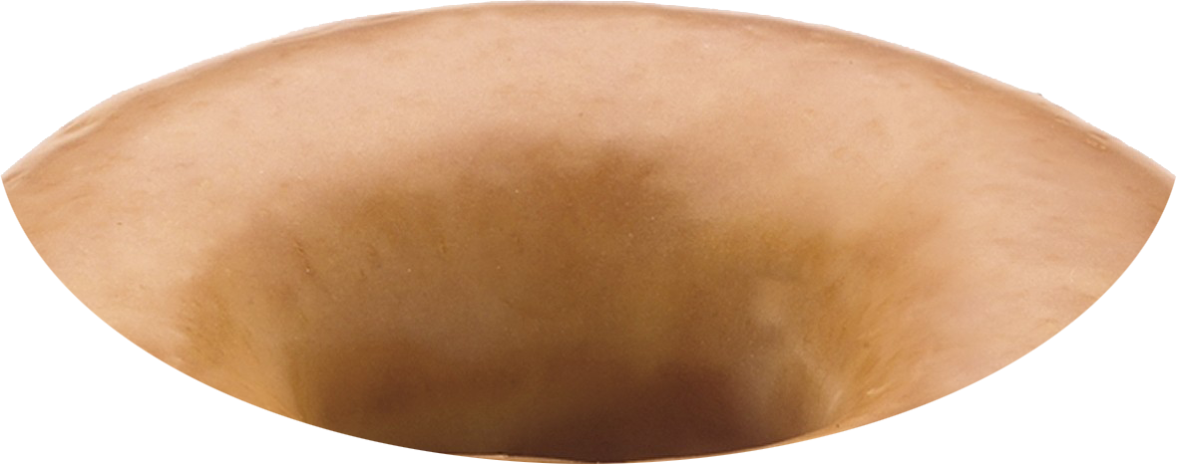
SENIORS

Slide 32
Seniors and
the disabled
$250 rebate last year
drug discounts in 2011

Slide 33
CHILDREN
DENIED
COVERAGE

Slide 34
DROPPED
BECAUSE YOU’RE
SICK

Slide 35
SMALL BUSINESS
WHO PROVIDE
COVERAGE
Up to 1/3 costs covered through small business tax credits

Slide 36
NY Bridge Plan
Uninsured for 6 months
Citizens/Lawful Immigrants
Pre-existing condition

Slide 37
Individual assistance to consumers statewide
No charge to consumers

Slide 38
Stop High
Rates!
consumers saved 2.5% in 2010 because of reregulation

Slide 39
WHAT WILL
EVERYONE GET?

Slide 40
DROPPED
BECAUSE YOU’RE
SICK

Slide 41
INSURERS REFUSE
TO PAY YOUR BILLS

Slide 42
ANNUAL &
LIFETIME
LIMITS

Slide 43
GUARANTEE
OF HEALTH
SECURITY

Slide 44
SMALL BUSINESSES

Slide 45
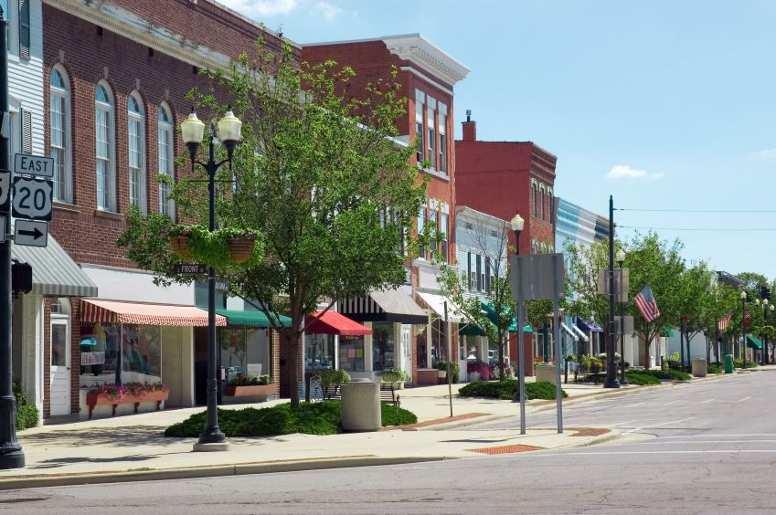
285,000 small businesses in
New York are eligible for tax credits to cover their employees

Slide 46
SMALL BUSINESS
TAX CREDITS
< 25 EMPLOYEES
AVERAGE WAGES: < $50K

Slide 47
SMALL BUSINESS
TAX CREDITS
UP TO 35%

Slide 48
SMALL BUSINESS
TAX CREDITS
2014 – 50%

Slide 49
LARGE EMPLOYERS
50+ EMPLOYEES
MAY PAY A FEE IF THEY
DON’T OFFER COVERAGE

Slide 50
LARGE EMPLOYERS
< 50 EMPLOYEES
CAN USE EXCHANGES

Slide 51
EXCHANGES

Slide 53
Affordable for
Individuals and
Businesses

Slide 54
PREMIUM
CREDIT
$88,000
FAMILY OF 4

Slide 55
FEE FOR CHOOSING
NOT TO BE COVERED
2014 - $95 or 1%
2016 - $695 or 2.5%

Slide 57
LIMIT
OUT-OF-POCKET
COSTS
$6K – INDIVIDUALS
$12K - FAMILIES

Slide 58
SENIORS AND
THE DISABLED

Slide 59
Prescription Drugs
Last year: $250 REBATE
This year: discounts

Slide 60
2020:
ALL DRUG
COSTS COVERED
(Pay only normal co-pays)

Slide 61
MAMMOGRAMS
COLONOSCOPIES
ANNUAL WELLNESS
VISIT

Slide 62
WASTE
FRAUD
ABUSE

Slide 63
Early Retirees:
55-64
Government reimburses for a portion of employee claims
Lower premiums or co-payments for early retirees’

Slide 64
CHILDREN AND
YOUNG ADULTS

Slide 65
CHILDREN
DENIED
COVERAGE

Slide 66
Stay On Your
Parent’s Insurance
Up to Age
26
In New York - 29

Slide 67
Maintained Until
2019

Slide 68
Low Income People and Medicaid
70,000 more childless adults enrolled
440,000 others predicted to enroll

Slide 69
IMMIGRANTS

Slide 70
EXCHANGES

Slide 72
MYTHS

Slide 73
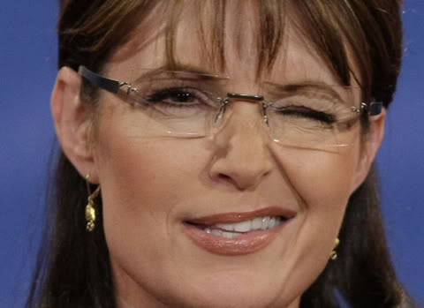
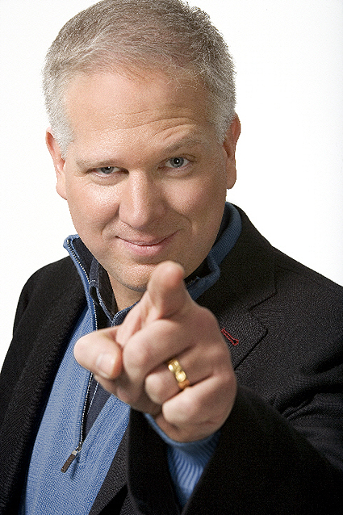
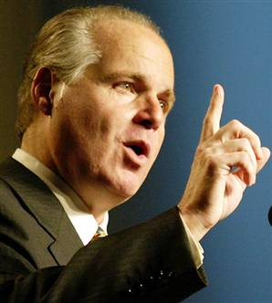

Slide 74
MYTH:
IT’S A
GOVERNMENT
TAKEOVER

Slide 75
TRUTH:
BUILDS ON THE
CURRENT SYSTEM
OF PRIVATE
INSURANCE

Slide 76
TRUTH:
NEW
RULES
FOR PRIVATE
INSURANCE

Slide 77
MYTH:
YOUR MEDICARE
BENFITS WILL
BE CUT

Slide 78
TRUTH:
BUDGET REDUCTIONS
AFFECT INSURANCE
COMPANIES AND
PROVIDERS

Slide 79
TRUTH:
THE NEW LAW
INCREASES
MEDICARE
BENEFITS

Slide 80
Summing Up

Slide 81
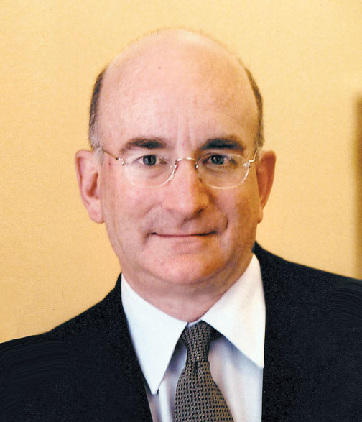
Alan Brinkley
Columbia University Historian

Slide 82
SPREAD
THE WORD
AND
THE TRUTH

Slide 83
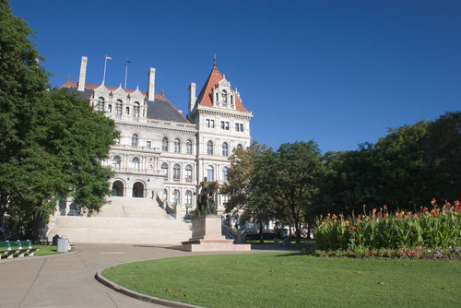

Slide 84
ADDRESS
RACIAL
DISPARITIES

Slide 85
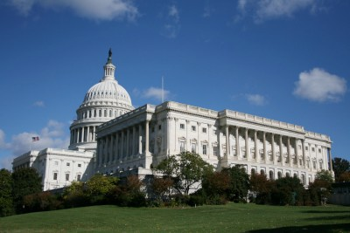

Slide 86
OVER 2 MILLION
NEW YORKERS
AFFORDABLE
COVERAGE OPTIONS

Slide 87
285,000 SMALL
BUSINESSES
TAX CREDITS
TO BUY INSURANCE

Slide 88
SENIORS AND THE DISABLED:
252,000 Got Checks

Slide 89
YOUNG ADULTS:
75,000 Covered

Slide 90
GUARANTEE
OF HEALTH
SECURITY

